Slide 1
CASE MANAGEMENT
&
COURT MANAGEMENT
- Roshan Dalvi

Slide 2
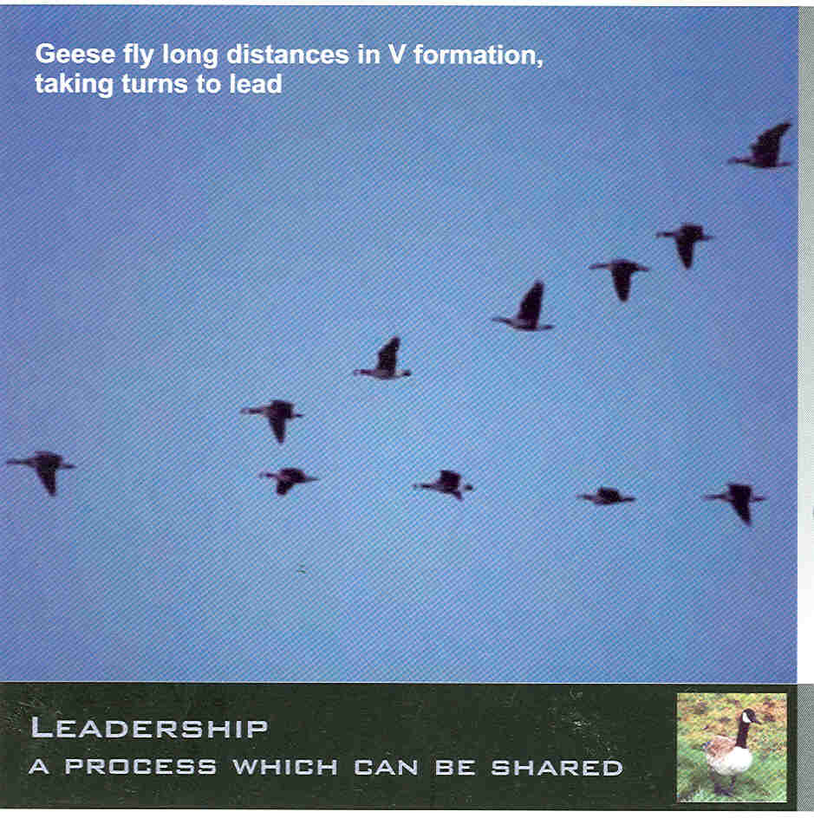

Slide 3


Slide 4


Slide 5


Slide 6


Slide 7
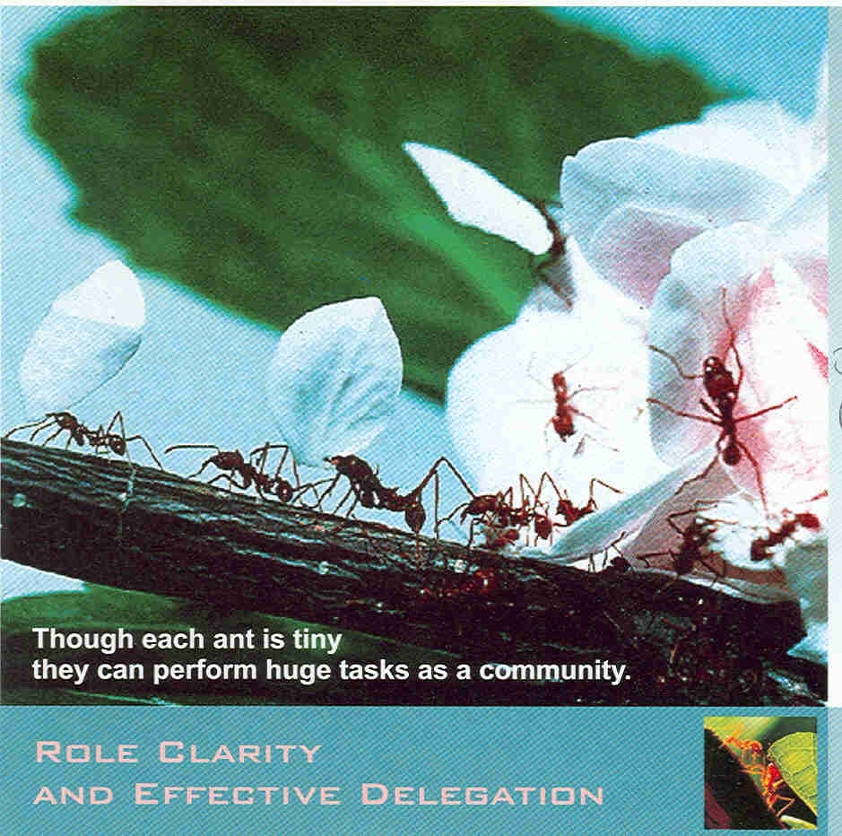

Slide 8


Slide 9


Slide 10


Slide 11
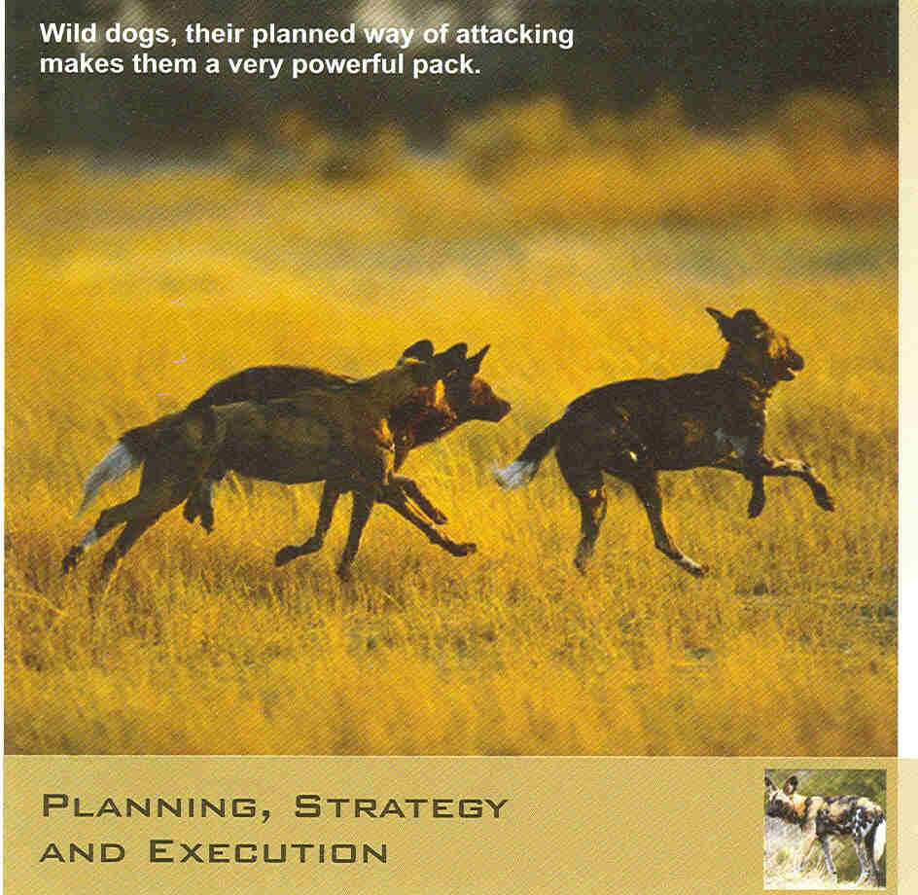

Slide 12


Slide 13
MANAGEMENT
Elements of management
  Planning
  Organising
  Directing
  Co-ordinating
  Controlling
  As propounded by the Management Guru, Peter Drucker
The best way to predict the future
is to create it
- Peter Drucker

Slide 14
MANAGEMENT (Contd…)
Relevant aspects of management in the Judiciary
  Non-value added items
  Core competence
  Time Management
  Procedural simplification
  Paradigms
Think Globally …… Act Locally

Slide 15
WHAT IS CASE MANAGEMENT?
Practitioners and Judges becoming better at what they do – i. e.,
Achieving the same end with less resources and in less time.
- Lord Justice Woolf,
Master of the Rolls, UK
How to do
MORE with less
To be a success in any thing –
Be Daring …… Be First …… Be Different

Slide 16
CASE MANAGEMENT - for what?
Improving efficiency
Reducing delays
Cutting costs
Judges who think they are too busy to manage cases are really too busy not to. Indeed, the busiest Judges with the heaviest dockets are the ones most in need of sound case management practices.
- William Schwarzer

Slide 17
Lord Woolf Report
Basic Features
Procedural simplicity for expedition
Control by Judges as soon as defence filed
Peculiar to England
Costs
Expert witnesses
Unlimited Legal Aid

Slide 18
Lord Woolf Report - Applicability
England
Simple Rules
Defence
Exchanging Witness statements
Small claims / Fast Track / Multi Track
Specialist Judges
Fixed Fees either for one stage or as a whole
ADR – A M C
Capping of costs
India
Amendment to CPC / HC Rules
WS / Affidavit-in-Reply
Affidavit of examination-in-Chief
Summary suits / Fast Track / Others
Civil / Criminal Judges
Original / Appellate Sides
Package Deal
ADR – A M C & Lok Adalat
Imposing realistic costs

Slide 19
Ambit of Case Management
Procedural
Substantive
Infrastructure
Sensitivity
requiring
Human mind is like a parachute;
It works only when it is open

Slide 20
STAGES OF CASE MANAGEMENT
Plaint
Service
Interim Applications
Ad-Interim relief
Returnable date
Rejection of Plaint
Court Commissioners
Oral applications

Slide 21
STAGES OF CASE MANAGEMENT (Contd…)
Disposal of Suits
Written Statement
Original documents
Preliminary Decree
Issues
Admissions
Evidence
Compilation

Slide 22
STAGES OF CASE MANAGEMENT (Contd…)
Arguments
Judgment
Judgment on Arguments
Costs
ADR
Summary Suits
Successful people do not do different things,
They do things differently.

Slide 23
ASPECTS OF COURT MANAGEMENT
Scrutiny
Technicalities
Directions
Certified Copies
Group matters
New Suits
Case tracking
Expedition Orders

Slide 24
ASPECTS OF COURT MANAGEMENT (Contd…)
Discharge of Suits on Board
Classification of Suits
Registrar’s Powers
Facilitation Counter
Amendment of Statutes regarding notice – s.80, s.527, s.164
The golden rule is :-
Jam Yesterday …. Jam Tomorrow, but NEVER jam today.

Slide 25
REQUIREMENTS FOR EFFECTIVE MANAGEMENT
Amendment to Orders in the CPC by the High Courts (CPC)
High Court Practice Directions (HCPD)
Judicial Training (JT)
Precedents
Court Administration (CA)
Courts sitting with one eye open on law and
one eye closed on society – Justice Krishna Iyer

Slide 26
The best 10 two-letter words –
If it is to be,
It is up to me.

